Slide 1
On Video
4c8
handout written by Prof. David Corrigan, based on Prof. Anil Kokaram material

Slide 2
Video
A Background to Film, Video and Analogue & Digital TV/Video Formats
Exploiting Temporal Redundancy is key to digital video processing
A process called motion estimation or optical flow
Video processing applications
Focus on compression
MPEG2/MPEG4

Slide 3
Film
First Moving Pictures were on film
First moving images 1872 because of a bet on a horse
Does a horse have all 4 hooves off the ground at any stage its trott?
Film is an analog medium but is discrete in time.
it consists of a series of images known as frames

Slide 4
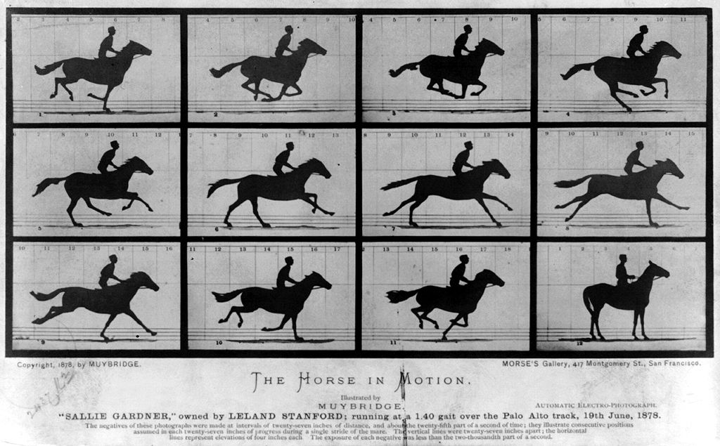
Yes

Slide 5
TV
TV is a technology for the transmission and reproduction of moving pictures
Rasterisation allowed images to be converted into 1D signals for transmission
Signals are continuous horizontally but discrete vertically and in time
CRTs used to project the signal.
John Logie Baird first to show that it could be used to transmit moving images.

Slide 6
TV
Nov 2nd 1936 BBC launched first regular “High Definition” TV Service
1953 3M viewers for coronation of queen = TV comes of age
Colour in 1954 in the USA (NTSC)
Europe used PAL and started colour in 1967

Slide 7
Video Recording
A method for storing TV signals on magnetic tape.
Came along after TV was invented .. Bummer
1950 RCA = longitudinal tape 6m/sec (early tapes used to be made of steel and burst a lot)
1953 = Ampex corporation helical scan (yea!)
1972 Philips home video
1978 Betamax (Sony) Vs VHS (Panasonic)
1980 VHS standard
1995 Digital Betacam, Digital-S [Broadcast]
1998 DVD and Digital
2007 HD, DV, Blu-Ray, HDV

Slide 8
Analogue Video
NTSC
PAL

Slide 9
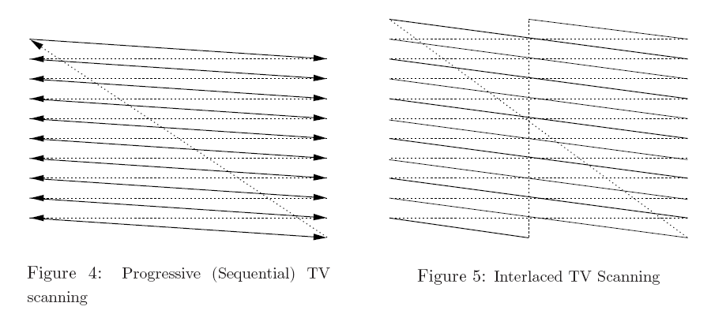
Progressive V Interlaced

Slide 10
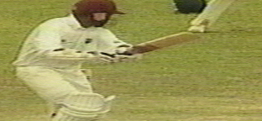
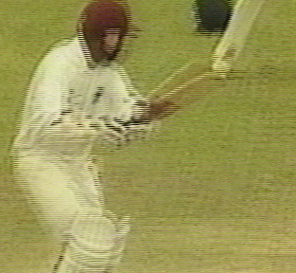
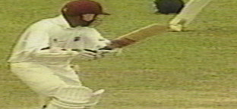
Interlacing makes it difficult to grab still frames from a TV
Even Field
2:1 Interlaced Frame
Odd Field

Slide 11
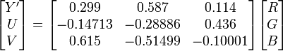
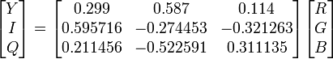
NTSC v PAL
 | PAL | NTSC
Colour Space | YUV | YIQ
Number of Lines | 625 (576 visible) | 525 (480 visible)
Frame Rate | 25 | 30
Interlaced | Yes (50 Hz) | Yes (60 Hz)

Slide 12
Digital Video Capture

Slide 13
Digital Video Capture

Slide 14
Getting Colour

Slide 15
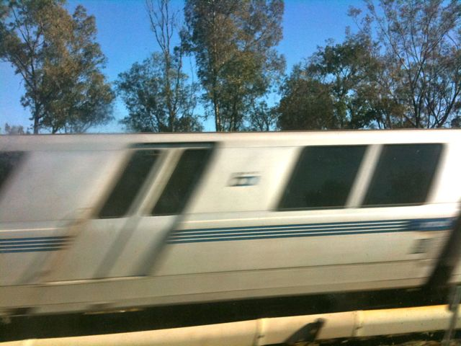
CCD v CMOS
Many consumer cameras use cheaper CMOS sensors
CMOS sensors use a “rolling shutter”
the sensor is exposed line by line rather than at once
this can lead to problems though

Slide 16
Digital Video Sizes & Formats

Slide 17
Digital Video Sampling

Slide 18
Pictures in Motion
Motion is a key concept in video processing.
Motion Estimation or Object Tracking is a key stage in nearly all video processing tasks
compression, video object segmentation, video denoise
We will look at a simple model for motion estimation for video sequences.
We will explore some well known techniques

Slide 19
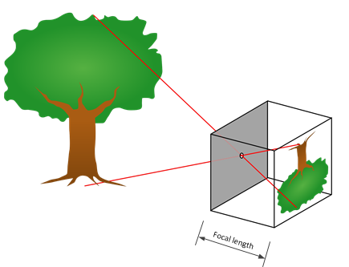
Pictures in Motion
Pinhole/Lens
Pinhole Camera Model
Imaging Sensor (eg. CCD)

Slide 20
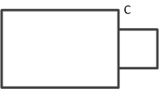
Projective Geometry
Pinhole

Slide 21
Estimating Object Motion
Not usually possible to estimate 3D Object Motion single video sequences.
It is possible when you have more than 1 camera capturing the object
V. interesting for multiview sequences (3D TV and 3D Cinema)
Will assume world is 2D and develop a simple model to describe the motion on a 2D plane

Slide 22
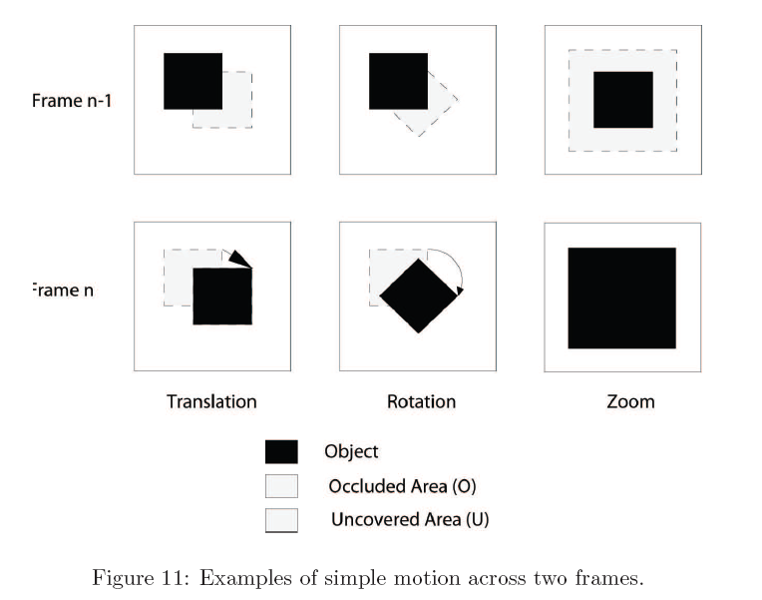

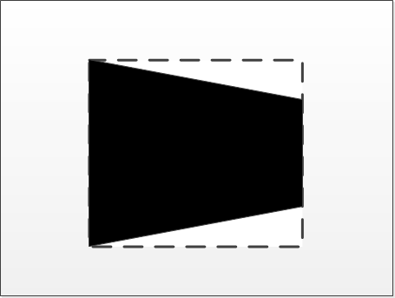
2D Motion

Slide 23
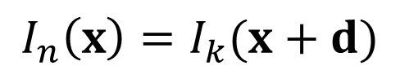
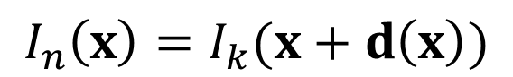
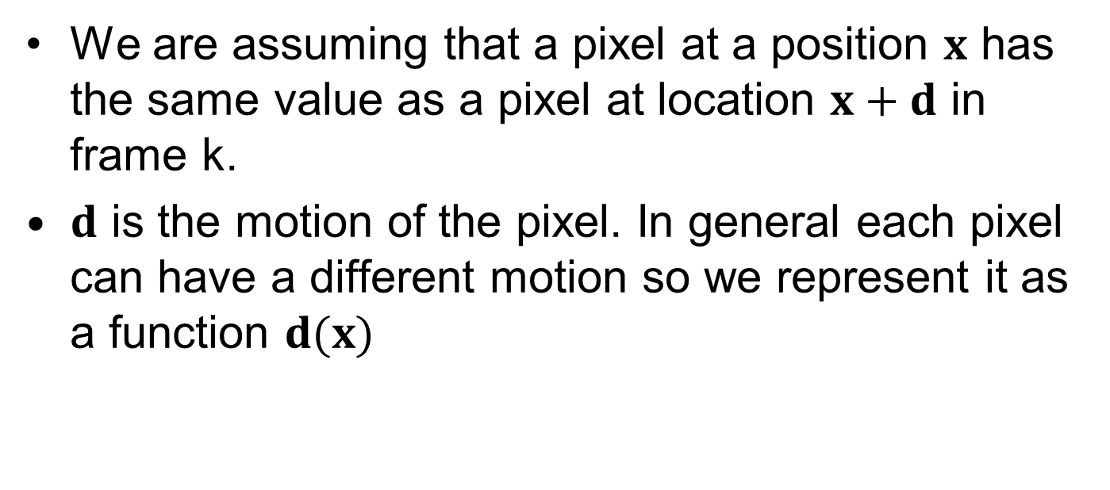
Motion Model
$$I_{n}\left(x\right)=I_{k}(x+d)$$
We are assuming that a pixel at a position $x$ has the same value as a pixel at location $x+d$ in frame k.
$d$ is the motion of the pixel. In general each pixel can have a different motion so we represent it as a function $d(x)$
$$I_{n}\left(x\right)=I_{k}(x+d\left(x\right))$$

Slide 24
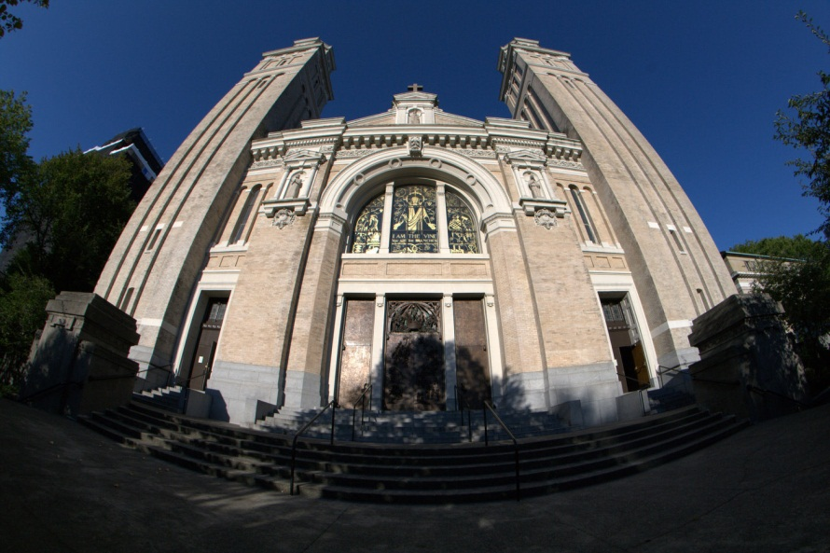
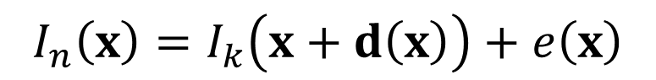
Complications
Luminance/Colour changes.
Occlusion.
Ill-posed Problem.
Aperture Effect.
Local versus global.
Model Complexity – Should we not consider rotation and scaling?
Lens Distortion.
Grain/Noise.
$$I_{n}\left(x\right)=I_{k}\left(x+d\left(x\right)\right)+e\left(x\right)$$

Slide 25
Displaced Frame Difference
If then we can define the Displaced frame difference as
To find the optimum motion field we need to find the motion vector field that minimises the DFD
minimises the sum (or mean) squared (or absolute) DFD.
or

Slide 26
Basic Strategies
Exhaustive Search/Block Matching
Try every possibility until the minimum is found
Easy to implement, suitable for hardware
Brute force => computationally intensive.
Limited precision and range
Gradient-Based Approaches (incl. Optical Flow)
Gets a closed form solution for motion using Taylor Series
Can give infinite precision
Only accurate for small motions
Harder to implement

Slide 27
Block Matching (Full Motion Search)
Example of exhaustive search method
Image is divided into blocks and a motion vector is found for each block.
Assumes that the motion is translational
Gets around the ill-posedness
User/Engineer must decide:
Block Size
Range of Motion Vector Candidates
Precision of Motion Vector Candidates

Slide 28
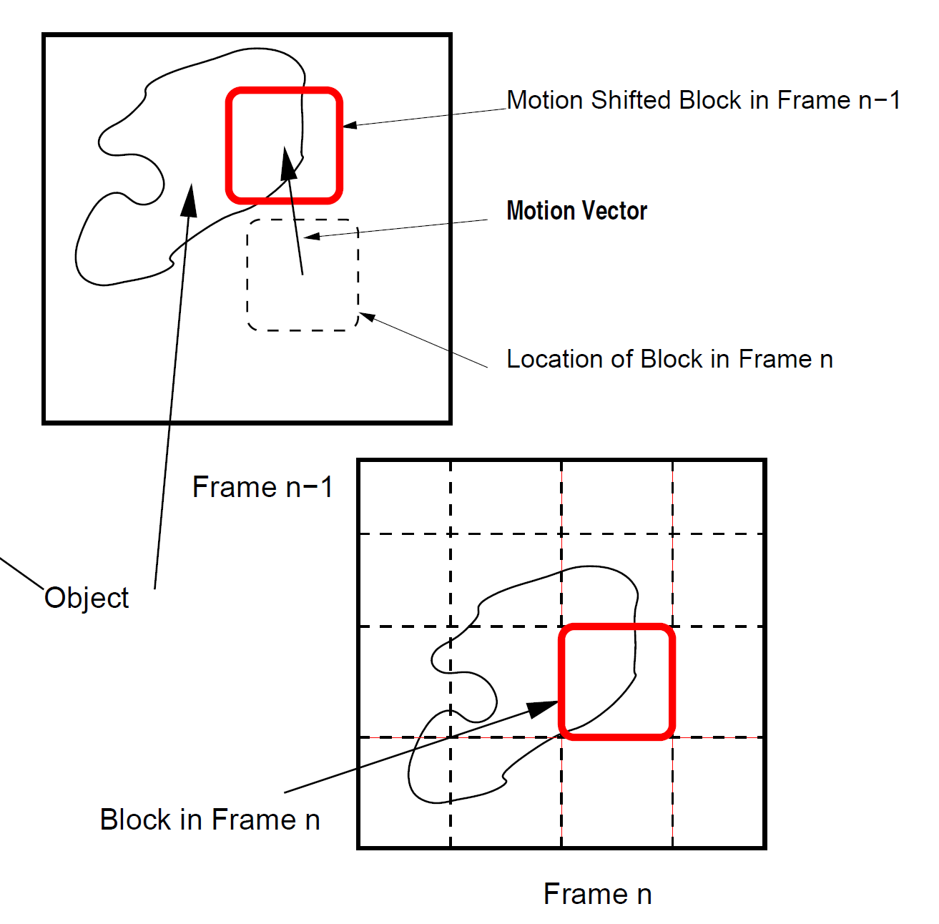
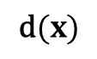
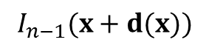
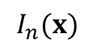
$$I_{n−1}(x+d(x))$$
$$\text{d}(x)$$
$$I_{n}(x)$$

Slide 29
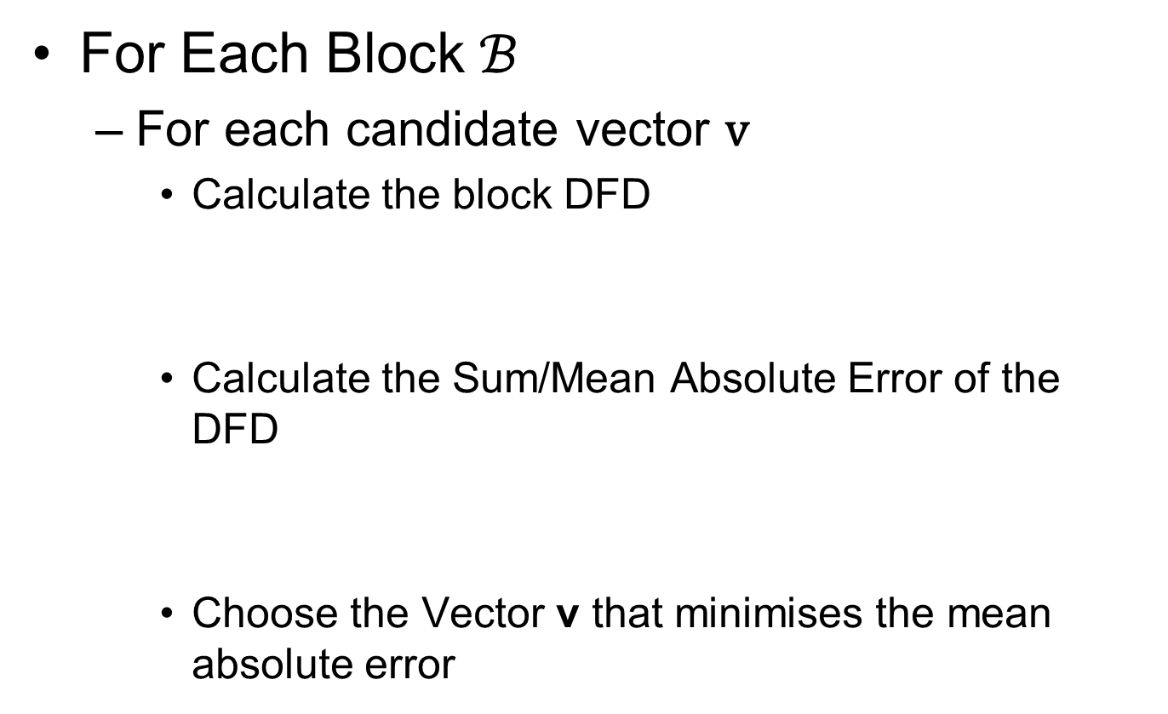
Full Motion Search Block Matching
For Each Block $ℬ$
For each candidate vector $\text{v}$
Calculate the block DFD
Calculate the Sum/Mean Absolute Error of the DFD
Choose the Vector v that minimises the mean absolute error

Slide 30
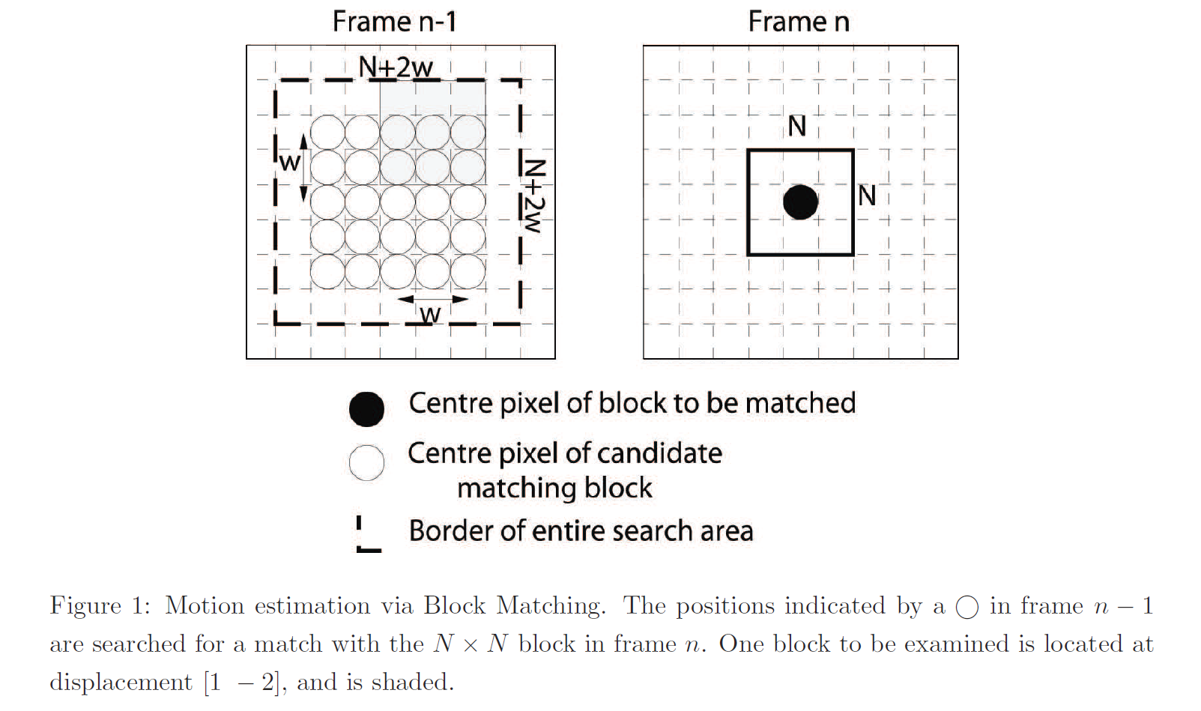
N is the block size
w is the search radius

Slide 31
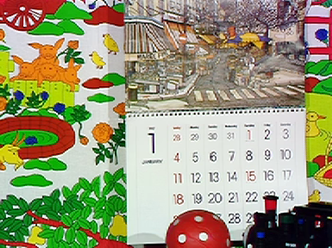
Note: Motion Estimation is typically done on the luminance channel only

Slide 32
Examples

Slide 33
Examples

Slide 34
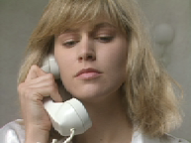

Slide 35
Examples

Slide 36
Measuring Performance
Quality
Mean Absolute (or Squared) error between the current frame and the motion compensated previous frame.
Computation
From execution time
But need to count number of operations as well.

Slide 37
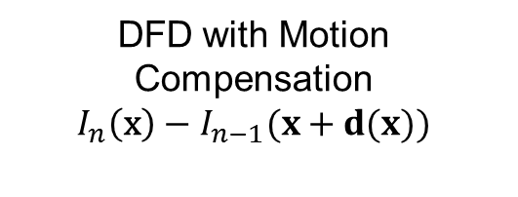
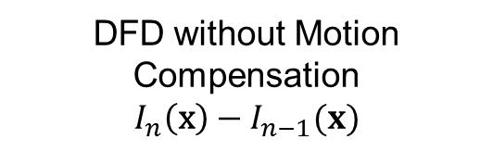
Comparing Quality
DFD with Motion Compensation
$$I_{n}\left(\text{x}\right)−I_{n−1}(x+d(x))$$
DFD without Motion Compensation
$$I_{n}\left(\text{x}\right)−I_{n−1}(x)$$

Slide 38
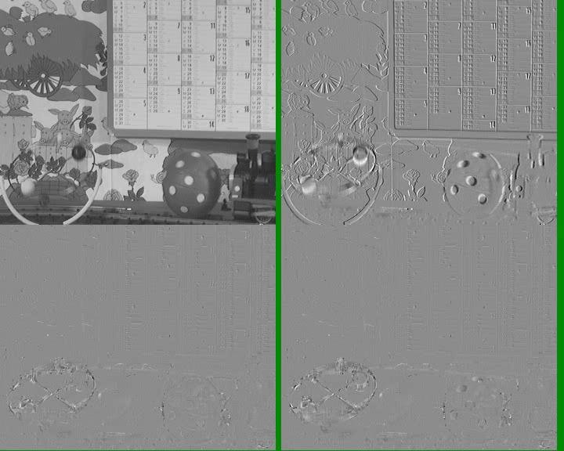

Slide 39
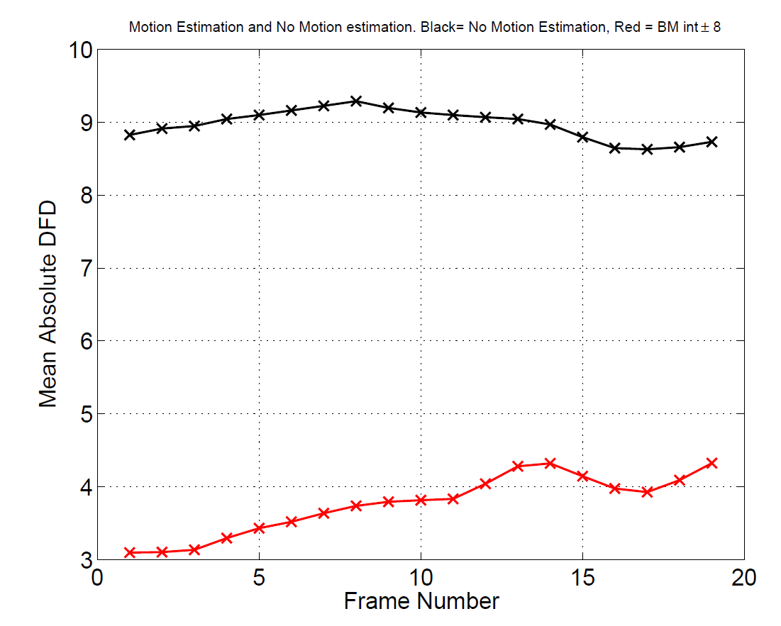
Comparing Quality
No Motion Compensation
Motion Compensation

Slide 40
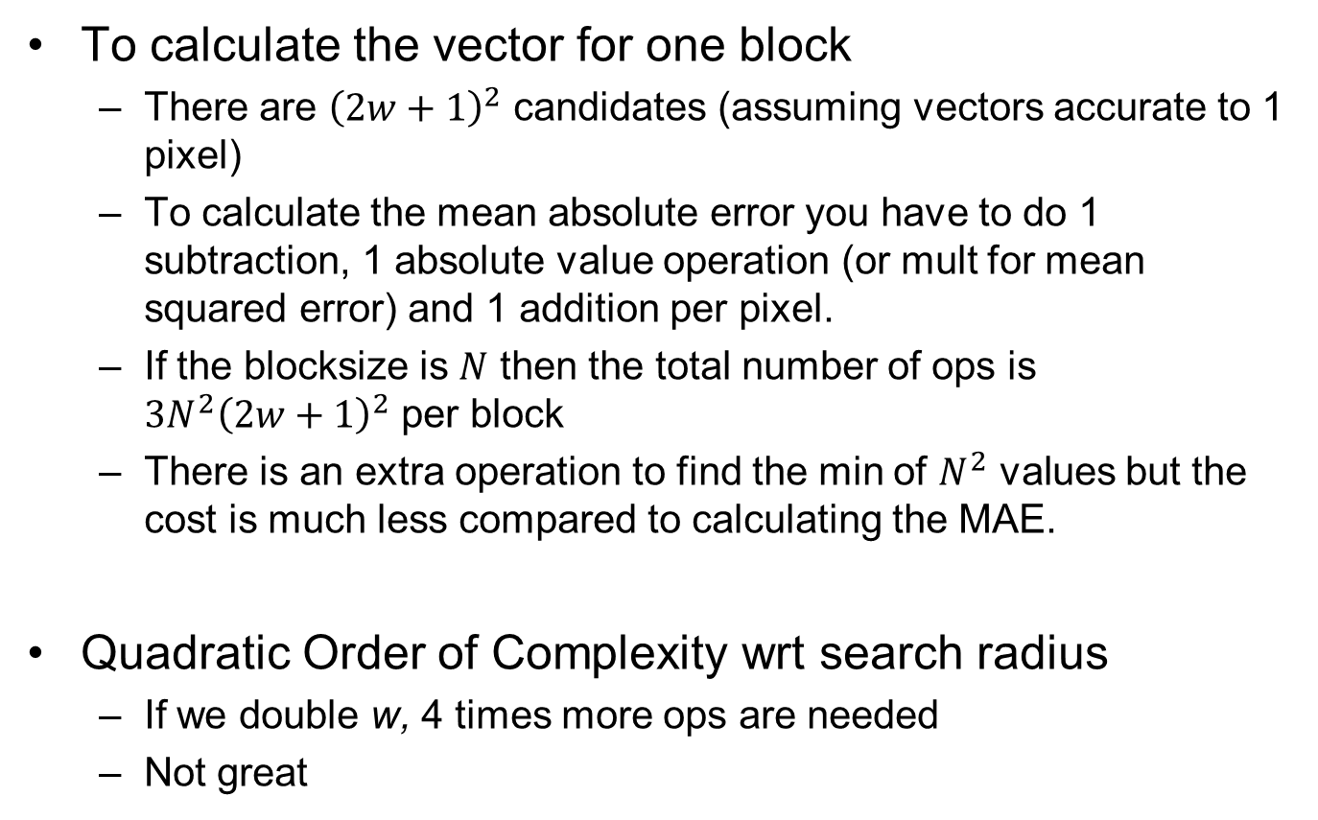
Computational Efficiency
To calculate the vector for one block
There are ${\left(2w+1\right)}^{2}$ candidates (assuming vectors accurate to 1 pixel)
To calculate the mean absolute error you have to do 1 subtraction, 1 absolute value operation (or mult for mean squared error) and 1 addition per pixel.
If the blocksize is $N$ then the total number of ops is $3N^{2}{\left(2w+1\right)}^{2}$ per block
There is an extra operation to find the min of $N^{2}$ values but the cost is much less compared to calculating the MAE.
Quadratic Order of Complexity wrt search radius
If we double w, 4 times more ops are needed
Not great

Slide 41
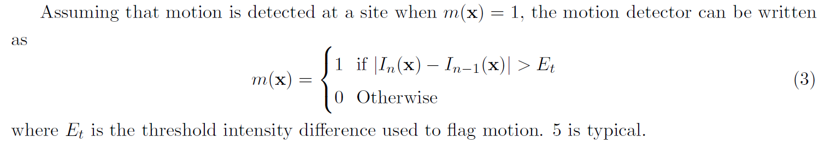
Improving Complexity
Motion Detection
Only do motion estimation where the frame difference is large

Slide 42
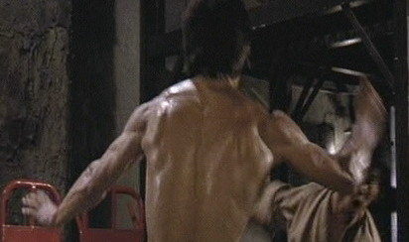
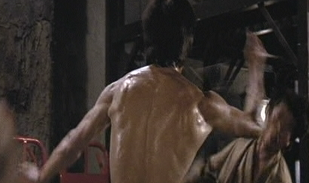
Pixel Difference for Motion Detection
Frame n-1
Frame n

Slide 43
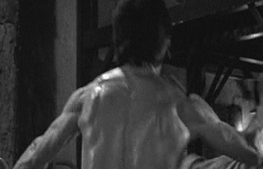
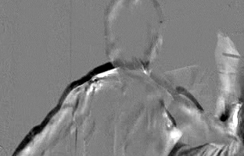
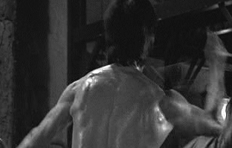
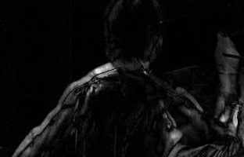
Pixel Difference for Motion Detection
Frame n-1
Frame n

Slide 44
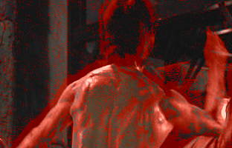


Pixel Difference for Motion Detection
Threshold = 5
Low Pass Filtering of the DFD
Threshold = 5
Smoothed abs(PD)

Slide 45
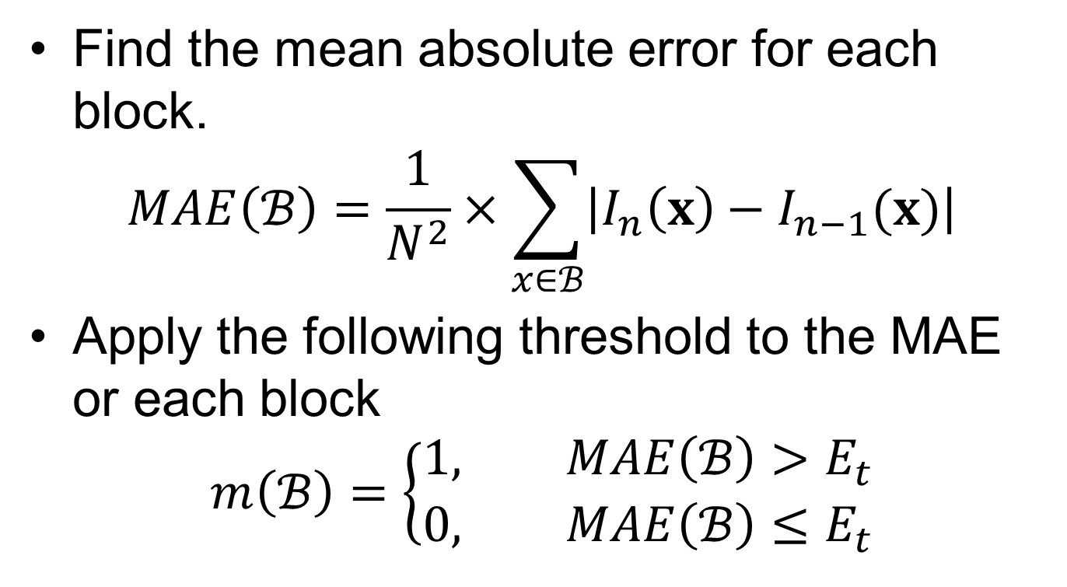
Motion Detection Algorithm for Block Matching
Find the mean absolute error for each block.
$$MAE\left(ℬ\right)=\frac{1}{N^{2}}×\sum_{x∈ℬ}{\left|I_{n}\left(x\right)−I_{n−1}(x)\right|}$$
Apply the following threshold to the MAE or each block
$$m\left(ℬ\right)=\left\{\begin{aligned}1, MAE\left(ℬ\right)>E_{t} \\ 0, MAE\left(ℬ\right)≤E_{t}\end{aligned}\right.$$

Slide 46
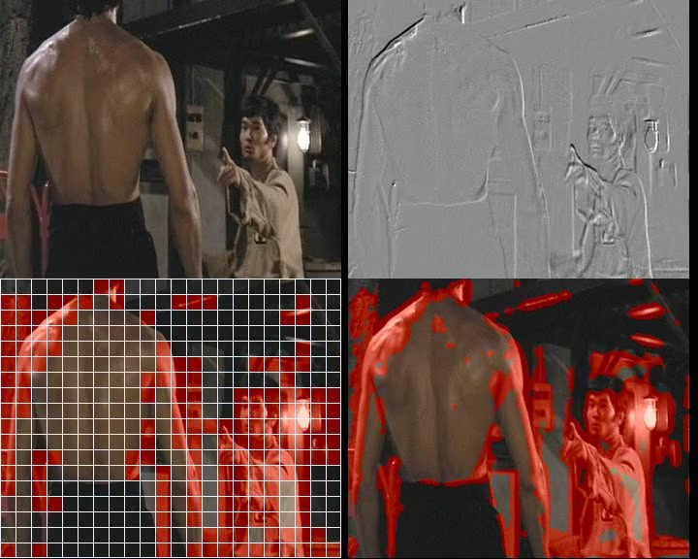

Slide 47
Improving Complexity
2. Don’t test all of the candidates.
Eg. The 3 step search
1. Search subset of evenly spaced candidates and find best candidate.
2. Use result of step 1 as centre for another search on a more closely spaced grid.
3. Repeat step two on a finely spaced grid.

Slide 48
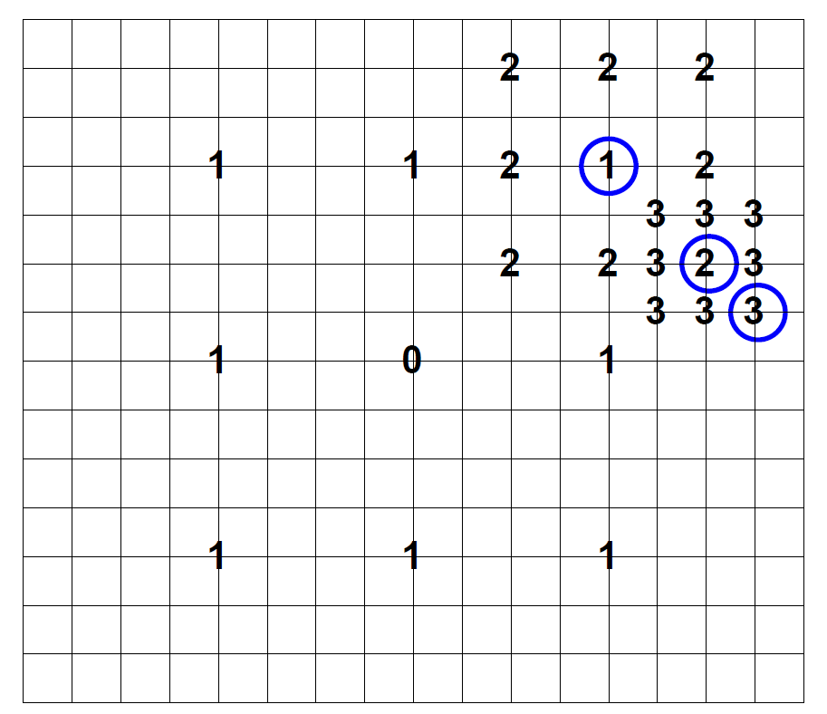
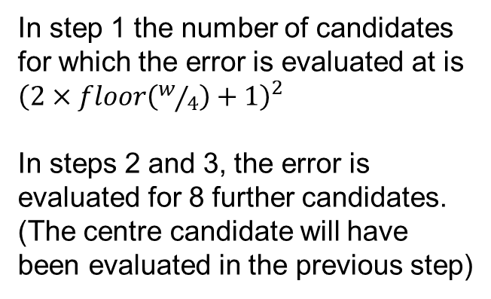
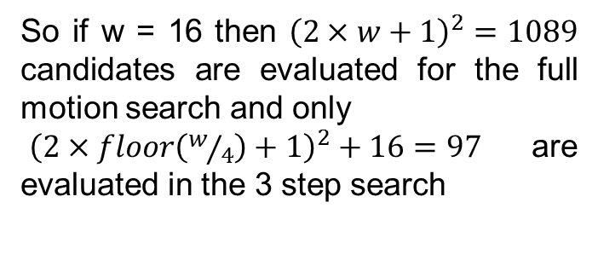
3-Step Search
In step 1 the number of candidates for which the error is evaluated at is ${\left(2×floor\left(w/4\right)+1\right)}^{2}$
In steps 2 and 3, the error is evaluated for 8 further candidates. (The centre candidate will have been evaluated in the previous step)
So if w = 16 then ${\left(2×w+1\right)}^{2}=1089$ candidates are evaluated for the full motion search and only
${\left(2×floor\left(w/4\right)+1\right)}^{2}+16=97$are evaluated in the 3 step search
Each intersection of lines corresponds to a potential motion candidate – the 3 step search allows you select the a vector without testing each candidate.
However the result is sub-optimal and therefore there will be a slight increase in the overall MAE.

Slide 49
Improving Complexity
3. Do a search at multiple resolutions and scales
The basic idea is to do the bulk of the search on lower resolution versions of the images.
For example if we have a block size of 16 and a search radius of 12 then at half picture resolution the equivalent block size would be 8 and search radius would be 6.
We can then do a smaller search at full resolution

Slide 50
Multiresolution Block Matching
Building the low pass pyramid.
For both frames we loss-pass filter and then downsample by a factor of 2. This is repeated multiple times
The low-pass filter prevents aliasing. A gaussian shaped filter mask is typical.
Level 0
Level 1
2D Gaussian mask – 15*15 taps
Level 2

Slide 51
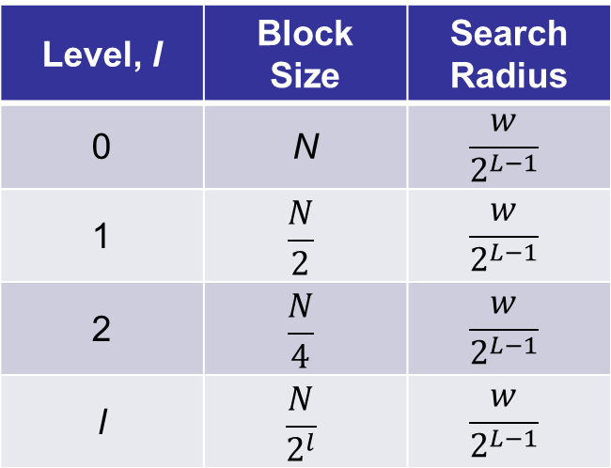
Multiresolution Block Matching
Algorithm:
Generate the L level pyramid for the current and previous frames. Level l = 0 is the full resolution and l = L-1 is the smallest resolution.
Set the initial level to l = L-1 and initialise all vectors to 0.
Generate an estimate of the motion field at level l, centring the search on the initial vector for that block.
If l=0 then go to step 7.
Propagate the motion field to level l -1. It is the initial field for level l -1.
Set level to l = l -1 and Go to Step 3.
Stop.
Level, l | Block Size | Search Radius
0 | N | $$\frac{w}{2^{L−1}}$$
1 | $$\frac{N}{2}$$ | $$\frac{w}{2^{L−1}}$$
2 | $$\frac{N}{4}$$ | $$\frac{w}{2^{L−1}}$$
l | $$\frac{N}{2^{l}}$$ | $$\frac{w}{2^{L−1}}$$
Block and Step Sizes to be used for the motion search at each at each level

Slide 52

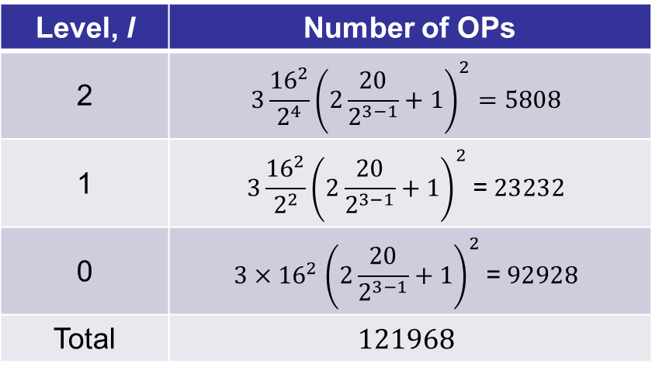
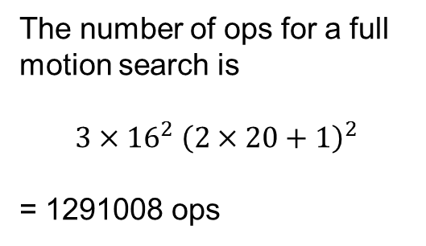
Multiresolution Block Matching
The number of ops at level l is $3{\frac{N^{2}}{2^{2l}}\left(2\frac{w}{2^{L−1}}+1\right)}^{2}$
So consider the example where we want to estimate motion where
the block size, N = 16
The search radius, w = 20
The Number of levels, L = 3
Level, l | Number of OPs
2 | $$3{\frac{{16}^{2}}{2^{4}}\left(2\frac{20}{2^{3−1}}+1\right)}^{2}=5808$$
1 | $$3{\frac{{16}^{2}}{2^{2}}\left(2\frac{20}{2^{3−1}}+1\right)}^{2}\text{= }23232$$
0 | $${3{×16}^{2}\left(2\frac{20}{2^{3−1}}+1\right)}^{2}\text{= }92928$$
Total | $$121968$$
The number of ops for a full motion search is
$$3{{×16}^{2}\left(2×20+1\right)}^{2}$$
= 1291008 ops
So a big drop in the number of computations.

Slide 53
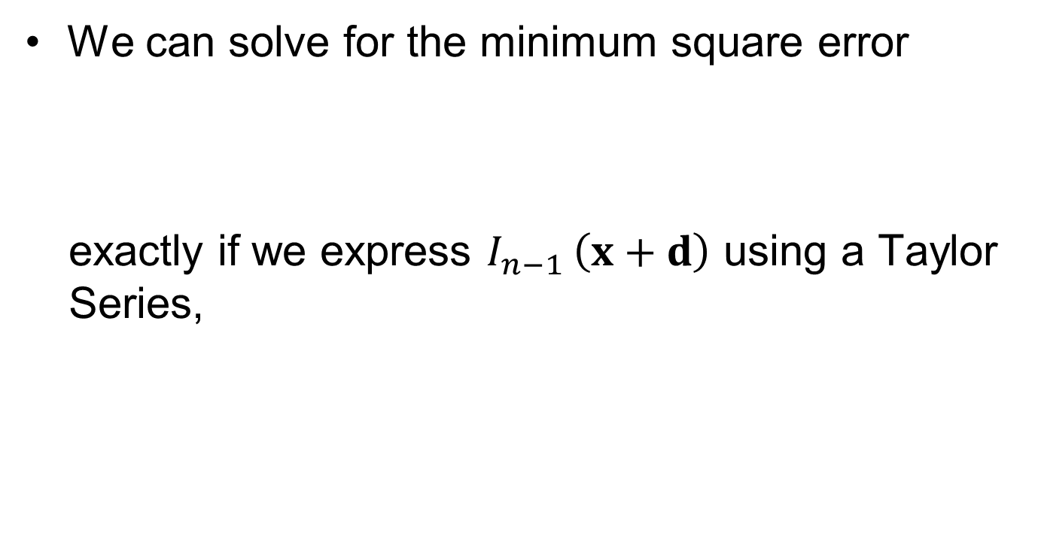
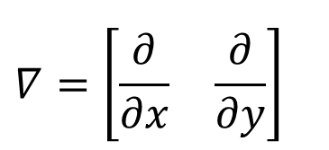
Gradient-Based Motion Estimation
We can solve for the minimum square error
exactly if we express $I_{n−1 }\left(x+d\right)$ using a Taylor Series,
$$∇={\left[\begin{matrix}\frac{∂}{∂x} & \frac{∂}{∂y}\end{matrix}\right]}^{}$$

Slide 54
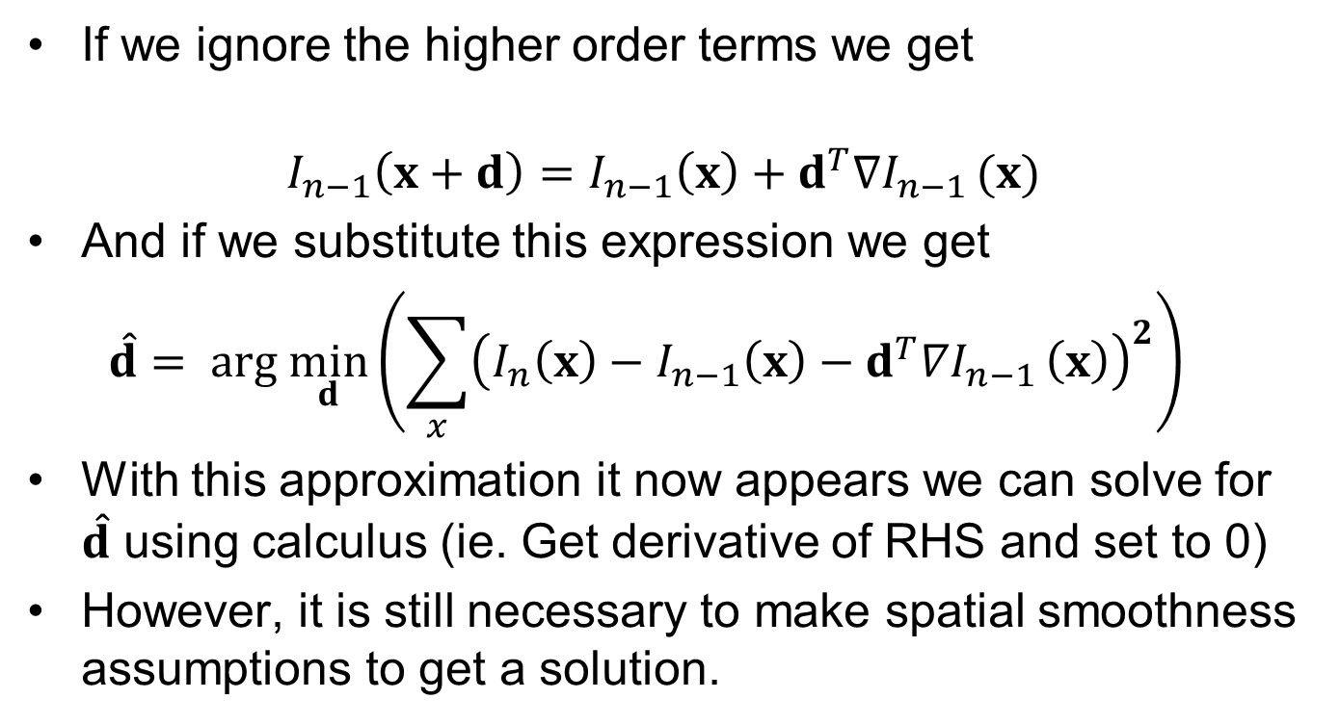
Gradient-Based Motion Estimation
If we ignore the higher order terms we get
$$I_{n−1}\left(x+d\right)=I_{n−1}\left(x\right)+d^{T}∇I_{n−1 }(x)$$
And if we substitute this expression we get
$${\hat{d}= arg \min_{d}\left(\sum_{x}{{\left(I_{n}\left(x\right)−I_{n−1}\left(x\right)−d^{T}∇I_{n−1 }\left(x\right)\right)}^{2}}\right)}^{}$$
With this approximation it now appears we can solve for $\hat{d}$ using calculus (ie. Get derivative of RHS and set to 0)
However, it is still necessary to make spatial smoothness assumptions to get a solution.

Slide 55
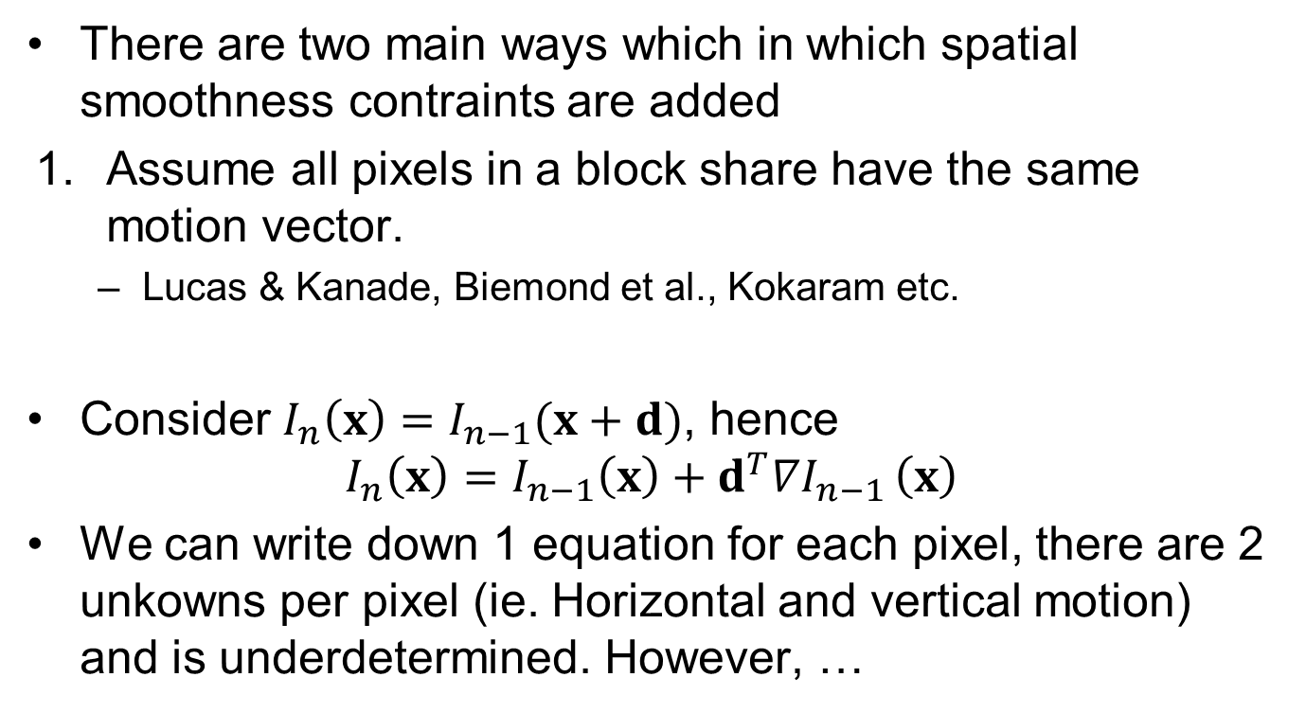
Gradient-Based Motion Estimation
There are two main ways which in which spatial smoothness contraints are added
Assume all pixels in a block share have the same motion vector.
Lucas & Kanade, Biemond et al., Kokaram etc.
Consider $I_{n}\left(x\right)=I_{n−1}(x+d)$, hence
$$I_{n}\left(x\right)=I_{n−1}\left(x\right)+d^{T}∇I_{n−1 }\left(x\right)$$
We can write down 1 equation for each pixel, there are 2 unkowns per pixel (ie. Horizontal and vertical motion) and is underdetermined. However, …

Slide 56




If all pixels in an N*N block have the same motion…
$I_{n}\left(x_{1}\right)=I_{n−1}\left(x_{1}\right)+d^{T}∇$ $I_{n−1}\left(x_{1}\right)$
$I_{n}\left(x_{2}\right)=I_{n−1}\left(x_{2}\right)+d^{T}∇$ $I_{n−1}\left(x_{2}\right)$
$I_{n}\left(x_{3}\right)=I_{n−1}\left(x_{3}\right)+d^{T}∇$ $I_{n−1}\left(x_{3}\right)$
$$⋮ ⋮ ⋮ ⋮ ⋮$$
$I_{n}\left(x_{N^{2}}\right)=I_{n−1}\left(x_{N^{2}}\right)+d^{T}∇$ $I_{n−1}\left(x_{N^{2}}\right)$
For each block e then get N² equations
with only 2 unknowns
This can be written in matrix
form as
$${DFD\left(x_{k}\right)=I}_{n}\left(x_{k}\right)−I_{n−1}\left(x_{k}\right)$$

Slide 57


Solving for d
Because there are more equations than unknowns only a least squares estimate is possible
So it is possible to estimate d without having to try every possible motion vector.
It can give estimates to “infinite” precision.
However, the higher order terms in the Taylor Series can only be ignored for small values of d. Therefore the result is only accurate if the motion is small.
$G$ is not a square matrix
$G^{T}G$ is a square matrix

Slide 58

Iterative Solution
The limited range can be overcome somewhat using multiresolution and an iterative approach.
Say we have an approximate solution d_{i} . Then we take the Taylor Series about x + d_{i} instead of x.
This results in a linear system of equations. Once we estimate u_{i} and hence d, we set d_{i} = d and repeat the process. Eventually the estimate will converge (ie u_{i} ≈ 0).
This is an example of the Gauss-Newton optimisation algorithm.
Update to current guess
True motion
current guess

Slide 59

2. An Alternative Approach
The well known Horn & Schunck algorithm does not assume the same motion over a block. Instead it assumes that the motion varies smoothly at each pixel.
We add this to the Taylor Series constraint
and therefore we try to find the motion that minimises
This looks tricky but it too reduces to solving a system of linear equations
Motion is smooth if D_{s}(x) is small

Slide 60

The Aperture Effect
The aperture effect causes ambiguity in motion estimation when the block size is too small.
The problem is that multiple candidate vectors will have the same error.
It is a problem of data quality and is a problem for all types of motion estimator.
Can be mitigated by increasing the block size or through multiresolution.

Slide 61
Aperture Effect
Aperture Effect is associated with
Regions of Uniform intensity
Straight Edges
Corners are immune to it and are good features for motion estimation
Feature detectors such as Harris, SIFT, Shi-Tomasi etc detect corners
Used for tracking and matching applications in computer vision.

Slide 62


Example of the Aperture Effect
Past Frame
Current Frame with Vectors
Only accurate vectors are at the corners.
Vectors inside the edge are incorrectly estimated as 0.
At the edges only the component of motion perpendicular to the edge is correct.

Slide 63
Pathological Motion
Types of behaviour that typically cause motion estimation failure
Fast Motion – eg. the size of the motion bigger than the search window for
Occlusions – The data might not be present in both views.
Transparency/Reflections – in effect their could be two motions, eg. one for the reflection and one for the mirror.
Non-rigid objects – (eg. Hair, flames etc) Motion is not rigid at these points
Motion Blur.

Slide 64
Summary
We have detailed a model to estimate motion in images.
We have looked at block matching in detail & also looked at gradient-based approaches.
We have explored the use of multiresolution and other approaches for optimising block matching.
We have looked at the aperture effect and potential issues affecting robustness.

